Slide 1
ESE 3002 PROJECT PREPARATION
SMART PARKING SYSTEM
BY
CHANDRA SHEKAR REDDY SAGA(C0747253)

Slide 2
CONTENTS
AIM
INTRODUCTION
FLOWCHART
BLOCKDIAGRAM
COMPONENTS
ADVANTAGES AND DISADVANTAGES
CONCLUSUION
REFERENCE

Slide 3
AIM
To reduce the time in search of parking in malls
and other public gathering places.

Slide 4
INTRADUCTION
By this smart parking system we can save more of our
without wasting in searching for empty slots.
It is an organized system for parking

Slide 5
FLOW CHART
start
Microcontroller transmitter
Microcontroller
receiver
Information to cloud
Data processing
Search other slot
Free slot
yes
Enter parking
No

Slide 6
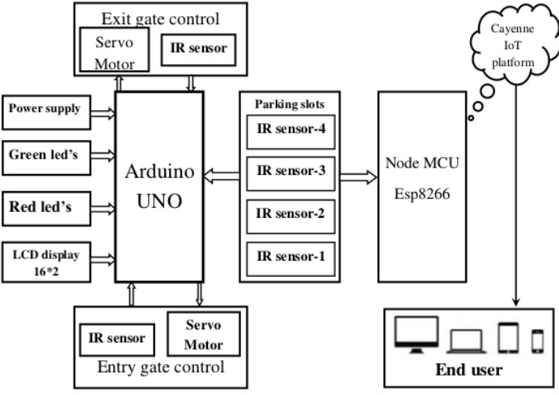
Block diagram.

Slide 7
Components
Arduino UNO
LCD
IR sensor
Servo motor
Node MCU
Led lights

Slide 8
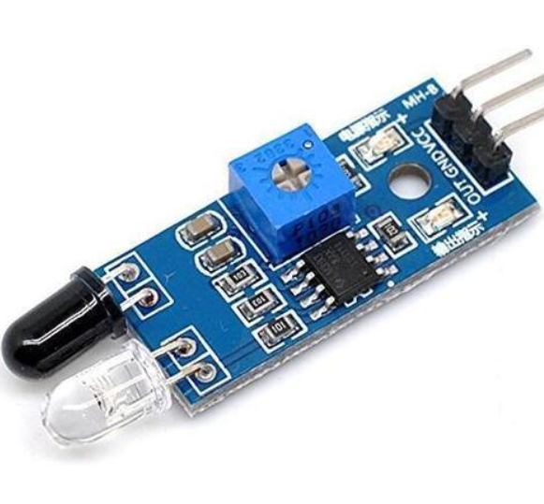
IR sensor
It turns to low level logic when an object is detected.
receiver
Emitter

Slide 9
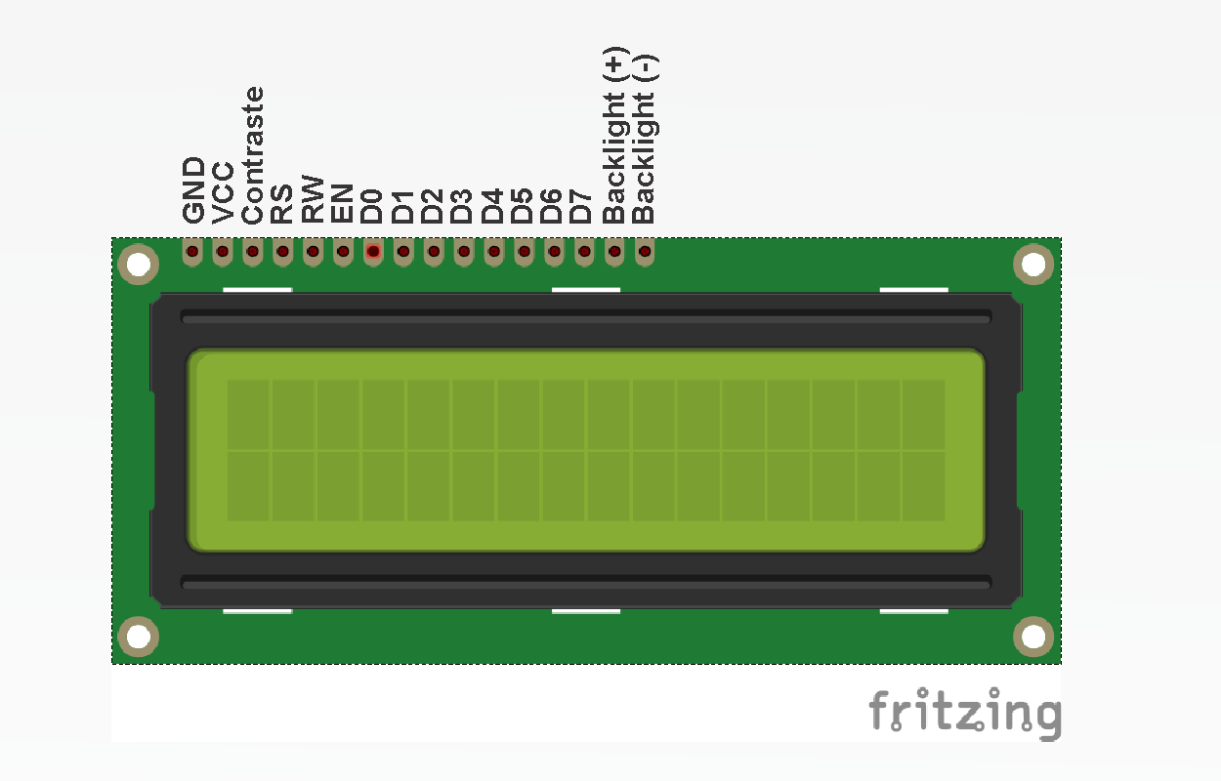
LCD display
A 16*2 LCD display was used to display the empty parking slot.
There will be 2 lines with 16 characters each.

Slide 10
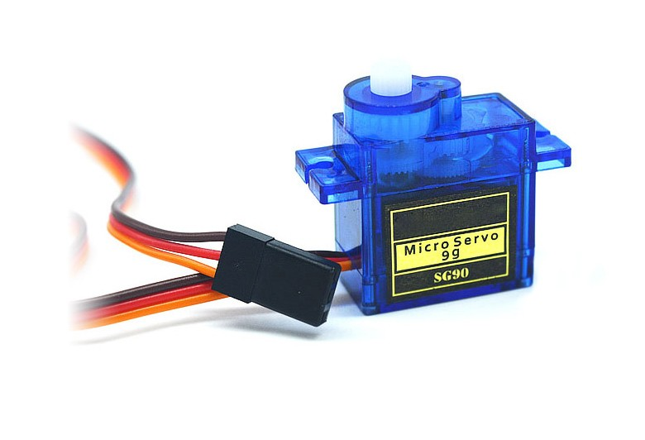
motor
Generally are used lo lift something from up to down or left to right.

Slide 11
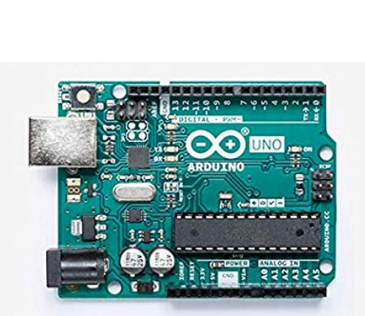
Arduino UNO
It has 16 MHz of clock speed
Operates with 5 v
It has 6 analog pins
32 kb flash memory
SRAM 2KB,EPROM 1KB
14 DIGITAL I/O pins

Slide 12
Node MCU
It can be programmed with Arduino IDE,C/C++,python basic.
It has 32 GPIO pins
4MB flash
64KB RAM
32 Bit RISC

Slide 13
Blynk App
Blynk App: it is an android app to control Arduino, Raspberry Pi and the likes over the Internet.
A graphical interface can be created according to the user to control and monitor the requirements.
It is a paid server.
With the help of app and mobile we can track the empty space.

Slide 14
Advantages
Waiting time will be decreased.
Saves fuel
Pollution can be decreased
Effective traffic management.

Slide 15
conclusion
By using internet and hardware we can detect parking space in a parking lot without wasting ang time.
Pollution problem can be solved by this system in metropolitan cities.

Slide 16


Slide 17
References.
Jung. H.G, Cho. Y.H, Yoon. P.J, and Kim. J,(2008) “Scanning laser radar-based target position designation for parking aid system,” IEEE Trans., vol. 9, no. 3, pp. 406-424.
Google, Wikipedia.

